Slide 1
Semantic Segmentation of the aerial/satellite imagery
Team – Space Applications Centre, ISRO

Slide 2
Problem Statement
Problem statement: Earth Observation Applications
Title: Semantic Segmentation of the aerial imagery
Technique Details: Semantic segmentation technique using Artificial Intelligence is the process of classifying each pixel in an image belonging to a certain class and hence can be thought of as a classification problem per pixel using AI methods. This technique is used here to classify each pixel in aerial imagery to a certain class.

Slide 3
Dataset Details
Orthorectified Images (ORI)
4 Channels: RGB and alpha
Digital Elevation Model (DEM)
Class Boundaries in GeoDataBase (.gdb)
Major classes are Vegetation, Roof/BuiltUp, Open Area, Road etc.

Slide 4
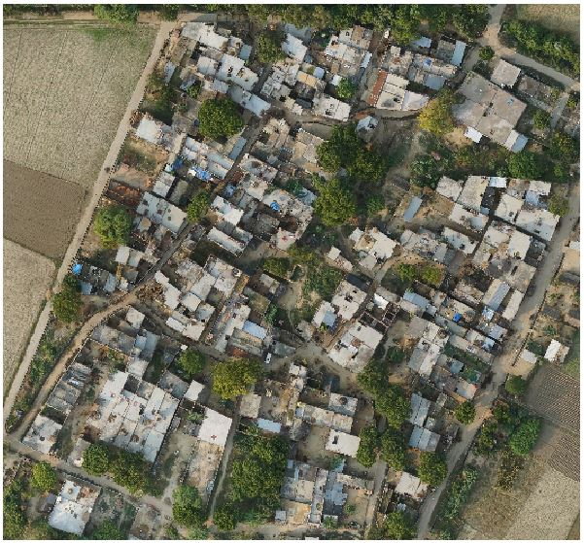
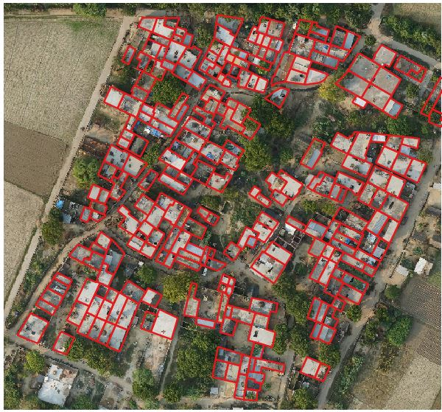
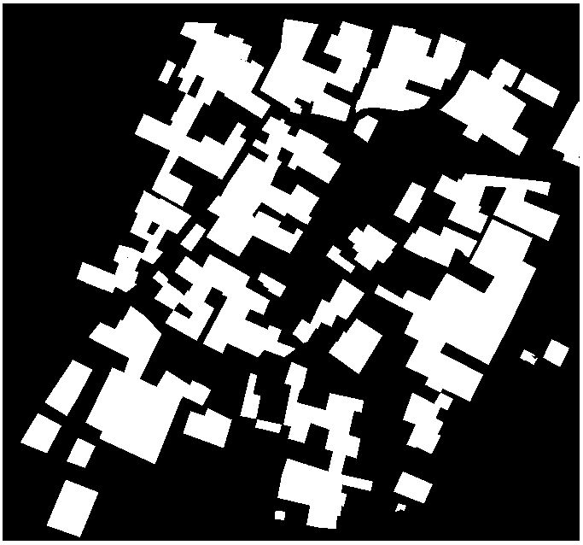
Dataset Preparation
Operations on ORI Data
Removal of alpha band
DEM image resampling and stacked with ORI data
Clipped stacked data with extent of ‘roof/builtup’ gdb.
4 Channels ORI
(R, G, B, DEM)
Operations on Class Boundaries
Vector data cleaning
Conversion of vector data to image mask keeping ORI data resolution.
Roof/BuildUp Mask

Slide 5
Challenges during dataset preparation
Challenges | Actions taken
Though dataset had multiple classes but only rooftop/ built-up were the only classes that were common across multiple datasets. | Semantic segmentation scope was reduced to produce semantic map for rooftop/ built-up class.
Rooftop/ built-up class was not properly labelled: Whole dataset was not labelled. Overlapping over other classes such as open-area, vegetation, trees etc. | Digitization was done for the rooftop/ built-up vector data extent. Removal of Overlapping of classes to some extent.
Datasets ORI Images and some of the provided vector data (GDB) were in different projection (ALUPUR, CHIBRAMAU, KANNAUJ(146874)) ORI images had either 3 or 4 (+alpha) channels Though sufficient ORI images were provided but associated vector data was incomplete. | Re-projection has been done. Alpha channel was removed from ORI images. Integrated DEM as one of the channel in input images. Data volume increased for training through augmentation techniques

Slide 6
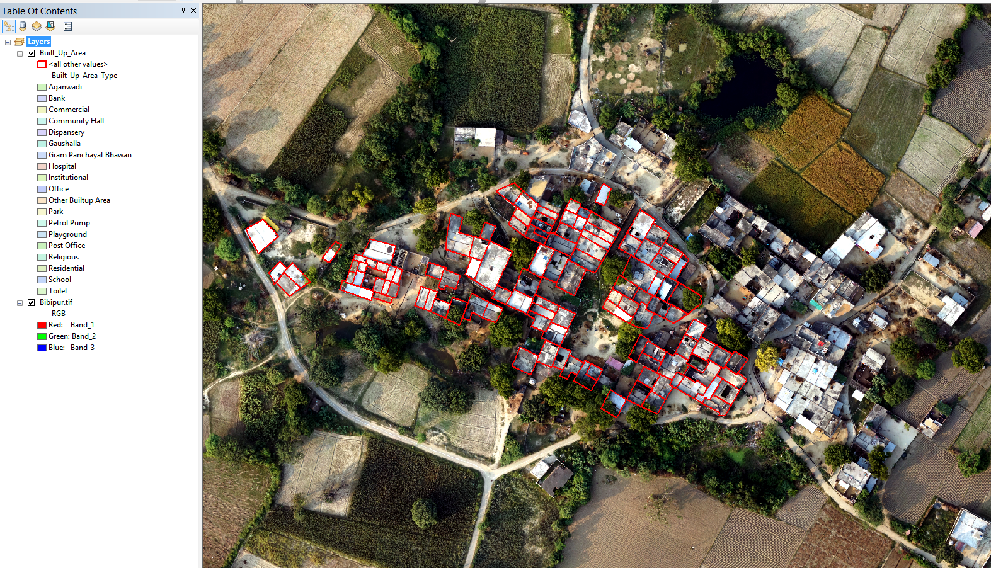
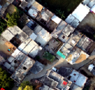
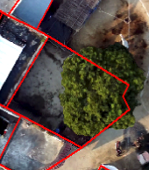
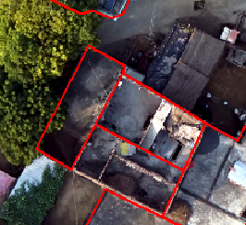
Challenges during dataset preparation
Un-labelled / Non- Digitized Data
Improper/ Cross Class Labelling
Open Area marked as Built-Up

Slide 7
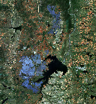
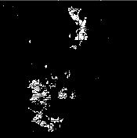
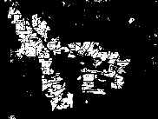
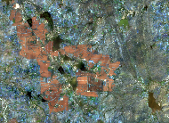
Block Diagram of Proposed Solution
High Resolution data download
Model deployment over web
Aerial Imagery
Data pre-processing
Model performance evaluation
Image stacking, re-projection, clipping etc.
Performance metrics (Jaccard Coefficient)
Labelled Data generation
Model training and hyper parameter tuning
+
=
Augmentation, Image tilling and use of data generator for better training process
Satellite Image + Labelled Data = Segmentation Result

Slide 8
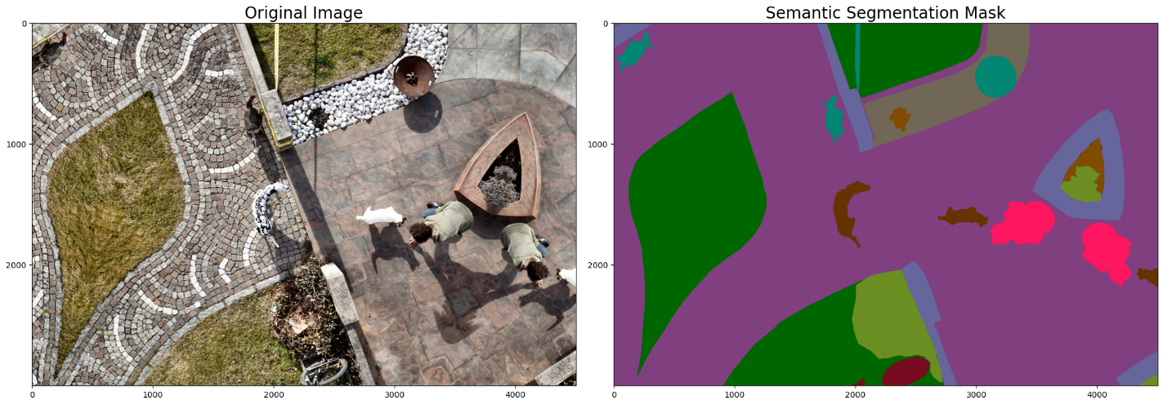
Explored Approaches
Developed prototype segmentation model on publically available data (semantic drone dataset).
Model didn’t performed well on SoI data because of:
Different resolution of train (public dataset) and test (SoI dataset) datasets.
Different Sensor sensitivity resulting into difference in tone, texture and context.
Tried transfer learning using VGG-16 and ResNet pretrained models. The pretrained models are trained on 3 channels RGB images only and hence cannot be scaled for more channels.
24 Classes:
paved-area, dirt, grass, gravel, water, rocks, pool, vegetation, roof, wall, window, door, fence, fence-pole, person, dog, car, bicycle, tree, bald-tree, ar-marker, obstacle, conflicting and unlabeled class.

Slide 9
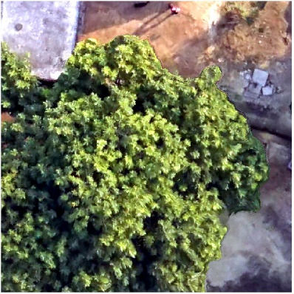

Explored Approaches for Training & Prediction
Adopted strategy involved creating train datasets from provided SOI data. Limited datasets were augmented and tiled to increase data volume.
(512, 512, 4) (512, 512, 1)
Use of Custom Data Generator to efficient utilization of memory resources.

Slide 10

Architectures - UNET
UNET is used for performing semantic segmentation of satellite imagery.
The architecture contains both encoder and decoder paths.
First path is the contraction path (also called as the encoder) which is used to capture the context in the image. The encoder is stack of convolutional and max pooling layers.
The second path is the symmetric expanding path (also called as the decoder) which is used to provide precise localization using transposed convolutions. It is an end-to-end fully convolutional network (FCN).
Labelled data is generated using satellite imagery for providing it to model with images for training.
Skip Connections
Skip Connections
Skip Connections
Fig.: Illustration of UNET Architecture with encoder and decoder path

Slide 11
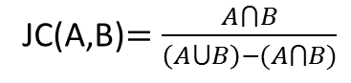
Architectures – UNET Attention
Attention
While traditional UNET takes skip connections directly as input, UNET-Attention or Attention aware UNET applies attention as ‘weights based on importance’ over skip connections.
The skip connections are later on concatenated with output layers at each depth in decoder path.
Skip Connections * Attention Weights
Skip Connections * Attention Weights
Skip Connections * Attention Weights
The Jaccard Coefficient (JC) is used as model loss (negative of JC) and performance metric in proposed solution. It is defined as:
JC(A,B)$=\frac{A⋂B}{\left(A⋃B\right)−(A⋂B)}$
Fig.: Illustration of UNET Architecture with encoder and decoder path

Slide 12
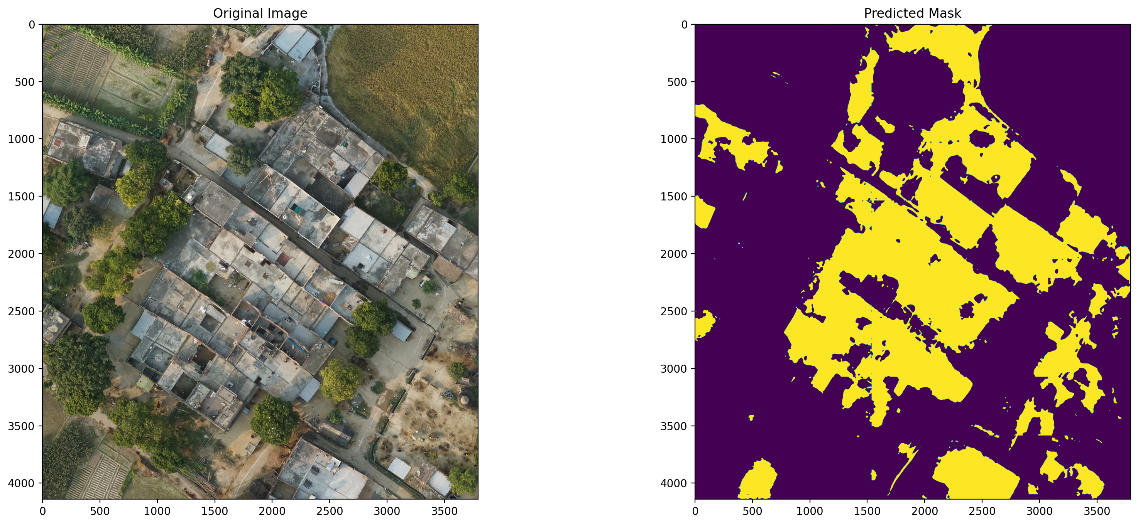
Results
Location: Bibipur
Model: UNET (Depth=4, Filters=32)
Jaccard Coef (Val) in % = 76.26%

Slide 13
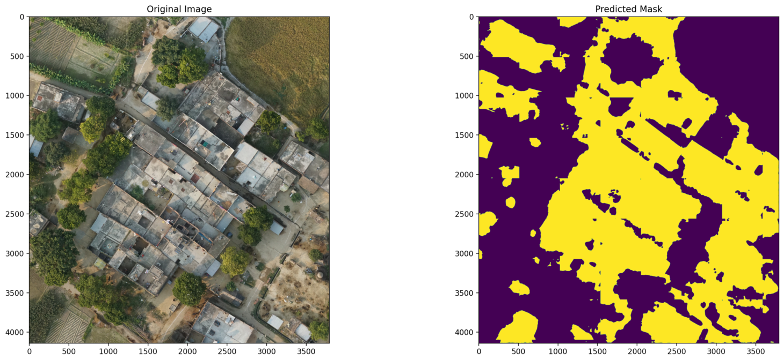
Results
Location: Bibipur
Model: UNET-Attention (Depth=4, Filters=32)
Jaccard Coef (Val) in % = 73.81%

Slide 14
Observations and Discussions in Model Development
Use of DEM channel improved Jaccard Coefficient (JC) by ~10%.
Rooftop/Built-Up class is misclassified in ‘road’ and ‘open area’ classes.
This could be due to improper labelling of pixels in input mask.
Some houses has open roofs exposing underneath floor. Such floors and roads has similar tone and texture which makes it hard to distinguish between them provided RGB and DEM bands.
The UNET architecture outperformed UNET-Attention architecture in various experiments conducted by varying hyperparameters.

Slide 15
Web Based Workbench
Customizable & Data independent deployment strategy.
Train
Data Preprocessing
Automatic Data Normalization
Augmentation
Image tiling
Random data splitting in train & validation sets.
Custom data generators
Live feedback from training process via plots
Automatic saving best model
Prediction
Selection of Trained Models with training accuracy.
Facility to upload Dataset for on-the-fly prediction.
Results visualization

Slide 16
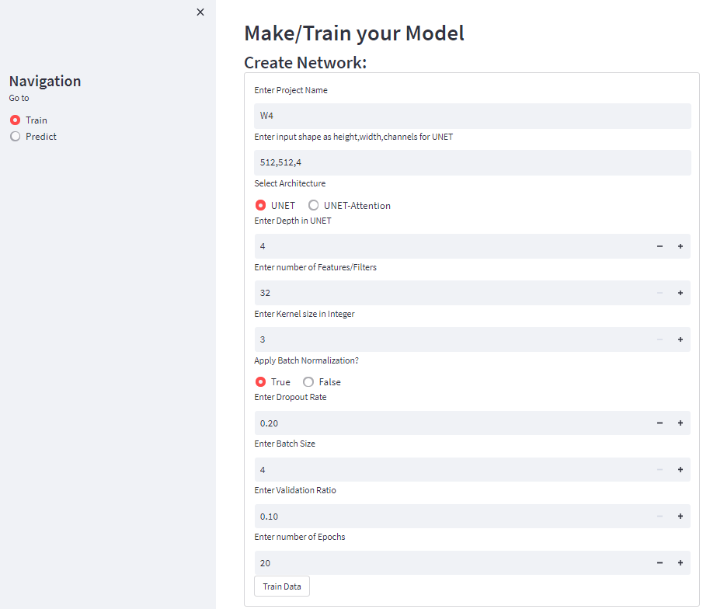
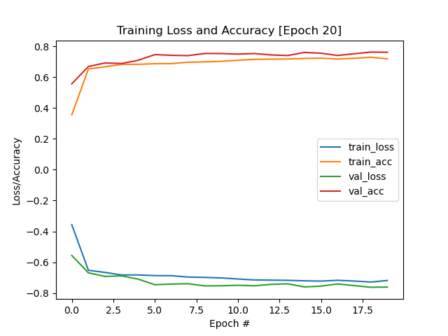
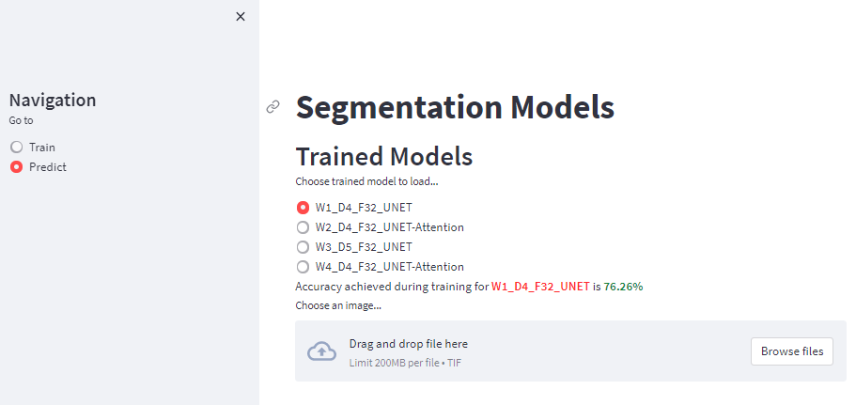
Web Based Workbench
Live feedback of Training process
Interface for Training Model
Interface for prediction using saved models

Slide 17
Conclusion
The developed models show satisfactory performance in semantic segmentation problem on SOI high resolution ORI datasets. The highest IoU achieved is 76.26 using UNET architecture.
Developed web based User Interface (UI) allows SOI users to have abstract controls over segmentation architectures through hyper-parameters tuning in training process and to save the same model for later predictions.
The web based UI also facilitates prediction using saved models over uploaded image.

Slide 18
!!! Thanks !!!

